Slide 1
Software Testing and Quality Assurance
Haiming Liu
liuhaiming@bjtu.edu.cn
School of Software Engineering
Beijing Jiaotong University

Slide 2
16 Weeks Plan
Week 1: The basic concepts and theories of testing
Week 2-3: Principles of Testing
Week 4: Testing the specification
Week 5-6: Black Box Testing
Week 7-9: White Box Testing
Week 10: Integration Testing and System Testing
Week 11: Usability Testing and Accessibility Testing
Week 12: Security Testing
Week 13: Mutation Testing
Week 14: Software Quality
Week 15: Review I
Week 16: Review II

Slide 3

Principle of Testing
Software testing axioms
It is impossible to test a program completely.
Software testing is a risk-based exercise.
Testing cannot show the absence of bugs.
The more bugs you find, the more bugs there are.
Not all bugs found will be fixed.
It is difficult to say when a bug is indeed a bug.
Specifications are never final.
Software testers are not the most popular members of a project.
Software testing is a disciplined and technical profession.
Notes:
软件测试公理
不可能完全测试程序。
软件测试是有风险的行为
测试不能显示潜伏的软件缺陷
发现的错误越多，存在的错误也就越多。
并非所有发现的错误都将得到修复。
什么时候叫缺陷很难说清楚
产品说明书没有最终版本。
软件测试人员不是项目中最受欢迎的成员。
软件测试是一个讲究条理的技术专业。

Slide 4
Principle of Testing
Parenthesis: What is an axiom anyway?
An axiom is a sentence or proposition that is not proved or demonstrated and is considered as obvious or as an initial necessary consensus for a theory building or acceptation.
Therefore, it is taken for granted as true, and serves as a starting point for deducing and inferring other (theory dependent) truths.

Slide 5
Principle of Testing
Axiom 1 It is impossible to test a program completely
The number of possible inputs is very large.
The number of possible outputs is very large.
The number of paths through the software is very large.
The software specification open to interpretation.
Notes:
输入结果太多
输出结果太多
软件执行的路径太多
软件说明书易于解释

Slide 6
Principle of Testing
Axiom 2 Software testing is a risk-based exercise
If you do not test the software for all inputs (a wise choice) you take a risk.
Hopefully you will skip a lot of inputs that work correctly.
What if you skip inputs that cause a fault?
Risk: financial loss, security, loss of money, loss of life!
That is a lot of pressure for a tester!
This course is all about techniques and practices to help reduce the risk.
Notes:
定理2 测试是有风险的行为

Slide 7
Principle of Testing
Axiom 2 (cont’d) Software testing is a risk-based exercise
If you try to test too much, the development cost becomes prohibitive.
If you test too little, the probability of software failure increases and as we discussed … software failures can cost us big time!
Number of
Missed Bugs
Cost of
Testing
number
Under
Testing
Testing
Equilibrium
Over
Testing
Amount of Testing

Slide 8
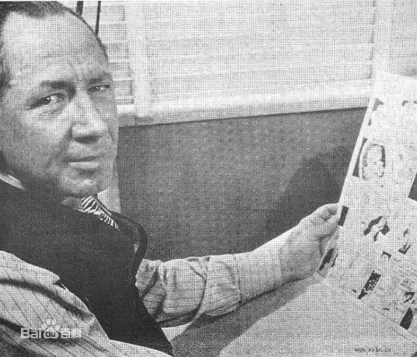
Principle of Testing
Axiom 2 (cont’d) Software testing is a risk-based exercise What about Murphy’s Law?
"If there's more than one possible outcome of a job or task, and one of those outcomes will result in disaster or an undesirable consequence, then somebody will do it that way.”
The law's name stems from an attempt to use new measurement devices developed by one Edward Murphy.

Slide 9

Principle of Testing
Axiom 3 Testing cannot show the absence of bugs
“Program testing can be used to show the presence of bugs, but never to show their absence!” - Edsger Wybe Dijkstra
Dijkstra received the 1972 ACM Turing Award for fundamental contributions in the area of programming languages
Notes:
测试无法显示潜伏的软件缺陷

Slide 10

Principle of Testing
Axiom 4 The more bugs you find, the more bugs there are
Bugs appear in groups, where you see one you will likely find more … Why?
Programmers can have bad days
Programmers tend to make the same mistakes
Some bugs are just the tip of the iceberg.
Boris Beizer coined the term pesticide paradox to describe the phenomenon that the more you test software the more immune it becomes to your test cases.
Remedy: continually write new and different tests to exercise different parts of the software.
Notes:
找到的软件缺陷越多，就说明软件缺陷越多

Slide 11
Principle of Testing
Axiom 5 Not all bugs found will be fixed
Why wouldn’t you fix a bug you knew about?
There’s not enough time
Some deadlines cannot be extended
It’s not really a bug
Specifications can be wrong
It’s too risky to fix
“I’m not touching Murphy’s code!”
It’s just not worth it
Bugs in fringe features may have to wait
Why not charge the customer for bug fixes in the next release (sound familiar?) :-)
Notes:
并非所有软件缺陷都要修复

Slide 12
Introduction
Axiom 6 It is difficult to say when a bug is indeed a bug
The software does not do something that specification says it should do.
The software does something that specification says it should not do.
The software does something that the specification does not mention.
The software does not do something that the specification does not mention but should.
The software is difficult to understand, hard to use, slow, or in the software tester's eyes will be viewed by the end user as just plain not right.
Notes:
什么时候才叫缺陷难以说清

Slide 13
Principle of Testing
Axiom 6 It is difficult to say when a bug is indeed a bug
If there is a problem in the software but no one ever discovers it … is it a bug?
What is your opinion? Does a bug have to be observable in order for it to be a bug?
Bugs that are undiscovered are called latent bugs.
"If a tree falls in a forest and no one is around to hear it, does it make a sound?"

Slide 14
Principle of Testing
Axiom 7 Specifications are never final
Building a product based on a “moving target” specification is fairly unique to software development.
Competition is fierce
Very rapid release cycles
Software is “easy” to change
Not true in other engineering domains
E.g., the Brooklyn Bridge could not be adjusted to allow train traffic to cross it once its construction started.
Notes:
产品说明书从没有最终版本

Slide 15
Principle of Testing
Axiom 8 Software testers are not the most popular members of a project
Goal of a software tester:
Find bugs
Find bugs early
Make sure bugs get fixed
Tips to avoid becoming unpopular:
Find bugs early
Temper your enthusiasm … act in a professional manner
Don’t report just the bad news
Notes:
定理8.软件测试员在产品小组中不受欢迎

Slide 16
Principle of Testing
Axiom 9 Software testing is a disciplined and technical profession
When software was simpler and more manageable software testers were often untrained and testing was not done methodically.
It is now too costly to build buggy software.
As a result testing has matured as a discipline.
Sophisticated techniques
Tool support
Rewarding careers
Notes:
定理9 软件测试是一个讲究条理的技术职业

Slide 17
Principle of Testing
You now know …
Product Components
SDLC
the 9 axioms of software testing
Notes:
…软件测试的9个公理
……什么是软件验证
……什么是软件验证

Slide 18
16 Weeks Plan
Week 1: The basic concepts and theories of testing
Week 2-3: Principles of Testing
Week 4: Testing the specification
Week 5-6: Black Box Testing
Week 7-9: White Box Testing
Week 10: Integration Testing and System Testing
Week 11: Usability Testing and Accessibility Testing
Week 12: Security Testing
Week 13: Mutation Testing
Week 14: Software Quality
Week 15: Review I
Week 16: Review II

Slide 19
Testing the specification

Slide 20
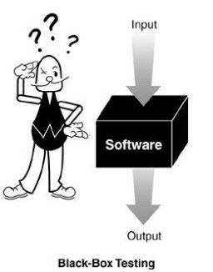
Black-box testing
Characteristics of Black-box testing:
Program is treated as a black box.
Implementation details do not matter.
Requires an end-user perspective.
Criteria are not precise.
Test planning can begin early.
Notes:
黑盒测试的特点：
程序被视为黑匣子。
实施细节无关紧要。
需要最终用户的观点。
条件不精确。
测试计划可以提早开始。

Slide 21
Static Testing is a type of a Software Testing method which is performed to check the defects in software without actually executing the code of the software application. Static testing is performed in early stage of development to avoid errors as it is easier to find sources of failures and it can be fixed easily. The errors that can’t not be found using Dynamic Testing, can be easily found by Static Testing.
Dynamic Testing is a type of Software Testing which is performed to analyze the dynamic behavior of the code. It includes the testing of the software for the input values and output values that are analyzed.
Notes:
静态测试指的是 测试不运行的部分，检查和审核
动态测试要求 使用和运行软件

Slide 22
Testing the specification
You do not need to have code to start testing.
Testing the specification can save on time and cost later on.
Also, mistakes in specifications account for about 55% of all bugs.
The specification is typically a written document using prose and pictures to describe the functional and non-functional aspects of the software.

Slide 23
Testing the specification
Requirements Specification: An Overview
Basic goal: To understand the problem as perceived by the user.
Activities of specification are problem oriented.
Focus on what, not how (this is design)
Don’t cloud the specification with unnecessary detail.
Don’t pre-constrain design in the specification.
After specification is done, do software design:
solution oriented
how to implement the what
Notes:
软件需求Specification：概述
基本目标：了解用户所感知的问题。
Specification的活动是以问题为导向的。

Slide 24
Testing the specification
Requirements Specification: An Overview
Key to specification is good communication between customer and developers.
Work from specification document as guide.
Basically, it’s the process of determining and establishing the precise expectations of the customer about the proposed software system.
Notes:
产品说明书的关键是客户与开发人员之间的良好沟通。

Slide 25
Testing the specification
The purpose of specification
Raw user requirements are often:
vague
contradictory
impractical or impossible to implement
overly concrete
just plain wrong
The purpose of specification is to get a usable set of requirements from which the system may be designed and implemented, with minimal “surprises”.
Notes:
原始用户需求通常是：
模糊的
矛盾的
不切实际或无法实施
过于具体只
是错误的

Slide 26
Testing the specification
The Specification document
The official statement of what is required of the system developers.
Includes system models, requirements definition, and requirements specification.
Not a design document.
States functional and non-functional requirements.
Serves as a reference document for maintenance.
Notes:
项目规范文档
有关系统开发人员要求的正式声明。
包括系统模型，需求定义和需求规范。
不是设计文件。
规定功能和非功能要求。
用作维护的参考文件。

Slide 27
Testing the specification
Two kinds of requirements
Functional: The precise tasks or functions the system is to perform.
e.g., details of a flight reservation system
Non-functional: Usually, a constraint of some kind on the system or its construction
e.g., expected performance and memory requirements, process model used, implementation language and platform, compatibility with other tools, deadlines, ...
Notes:
功能性：系统要执行的精确任务或功能。
非功能性的：通常是对系统或其结构的某种约束

Slide 28
Testing the specification
Specification document “requirements”
Should be easy to change as requirements evolve.
Must be kept up-to-date as system changes.
Foreseen problems:
“won’t support Win-3.x apps”
Expected evolution:
“will port to MacOS in next version”
Response to unexpected events/usage:
“if input data in old format, will auto-convert”
Notes:
产品说明书里的需求
应随需求的发展而轻松更改。
系统更新时必须保持最新。
预见的问题
预期的发展：
对意外事件/使用的响应

Slide 29
Testing the specification
Software Requirements Specification Structure
Introduction (describe need for system)
Functional Requirements
Non-Functional Requirements
System Evolution (describe anticipated changes)
Glossary (technical and/or new jargon)
Appendices
Index
Notes:
简介（描述系统需求）
功能要求
非功能要求
系统演进（描述预期的变化）
术语表（技术和/或新术语）
附录
索引

Slide 30
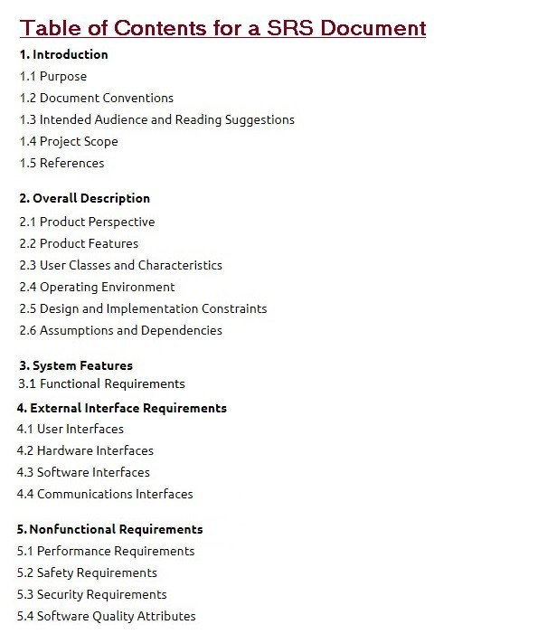
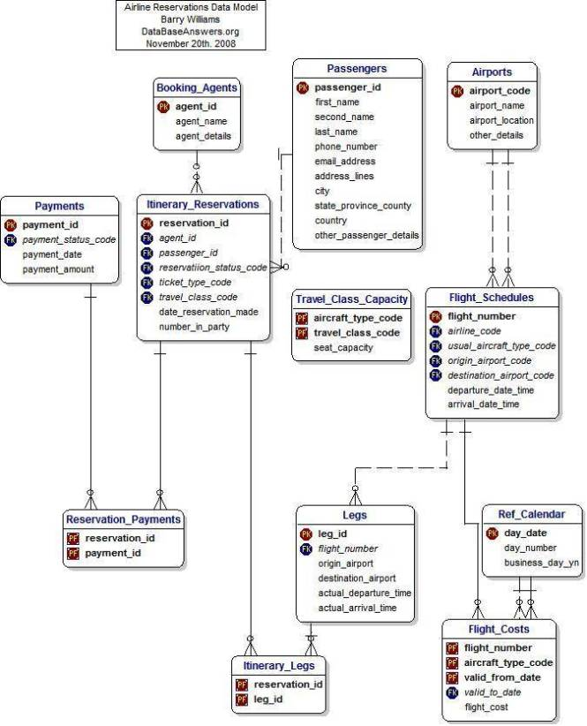
Testing the specification
Specification structure
Notes:
Software Requirements Specification

Slide 31
Testing the specification
To summarize …
Specification focuses on determining what the customer wants, and not how it will be implemented.
Specification is hard to get correct; it requires good communication skills.
Requirements may change over time.
Requirements specification requires iteration.
The customer often doesn’t have good grasp of what he wants.
Bugs created in the requirements stage are very expensive to fix later.
Notes:
产品说明书侧重于确定客户需要什么，而不是如何实现它。
产品说明书很难正确； 它需要良好的沟通能力。
需求可能会随着时间而变化。
需求规格说明需要迭代。
客户通常对自己想要的东西不太了解。
在需求阶段创建的错误在以后修复时非常昂贵。

Slide 32
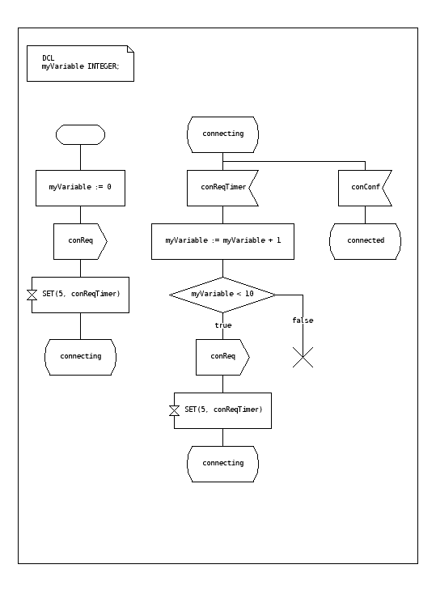
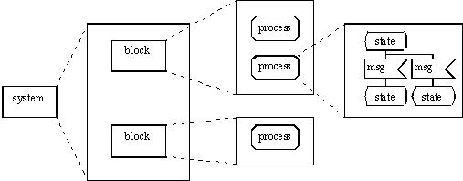
Testing the specification
Specification Languages and Tools
SDL (Specification and Description Language)
SDL is a specification language targeted at the unambiguous specification and description of the behaviour of reactive and distributed systems.
Notes:
SDL（规格与描述语言）

Slide 33
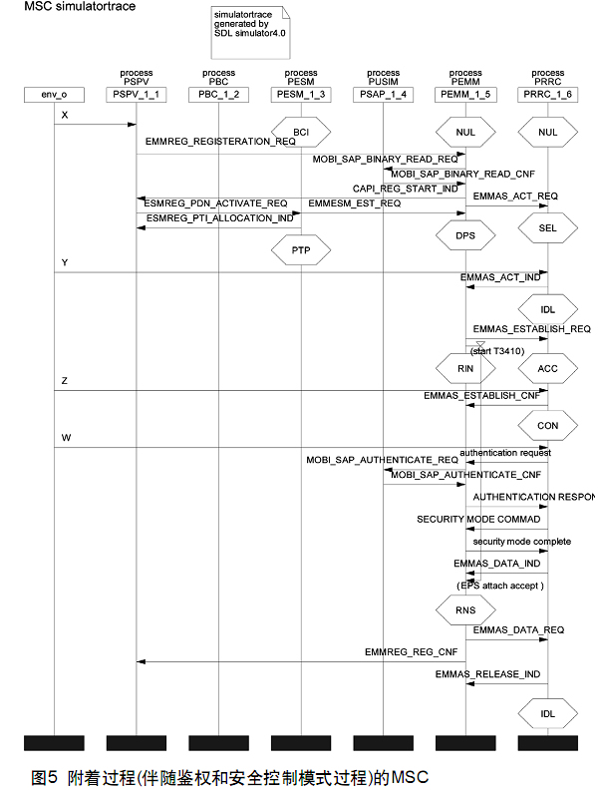
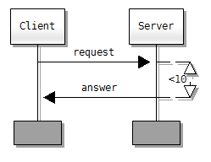
Testing the specification
Specification Languages and Tools
MSC (Message Sequence Chart)
MSC is an interaction diagram from the SDL family standardized by the International Telecommunication Union.
Notes:
MSC（顺序图）

Slide 34
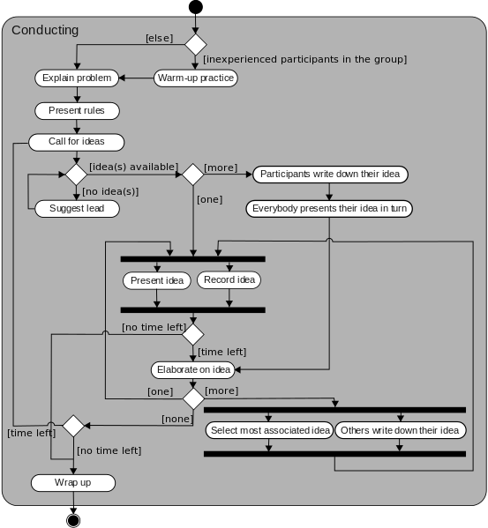
Testing the specification
Specification Languages and Tools
UML (Unified Modeling Language)
UML is a general-purpose, developmental, modeling language in the field of software engineering, that is intended to provide a standard way to visualize the design of a system.
Notes:
UML 统一建模语言，又称标准建模语言。

Slide 35
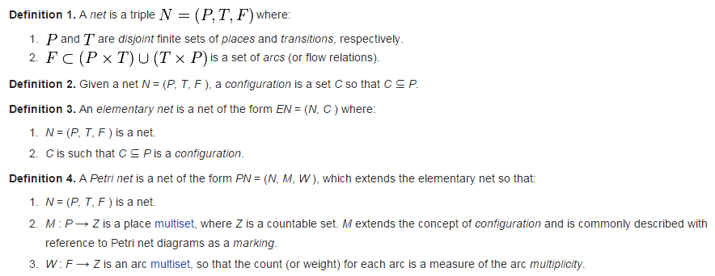
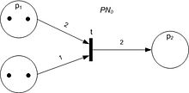
Testing the specification
Specification Languages and Tools
Petri Net
Petri Net is one of several mathematical modeling languages for the description of distributed systems.
Notes:
Petri Net(PN) 是对离散并行系统的数学表示

Slide 36
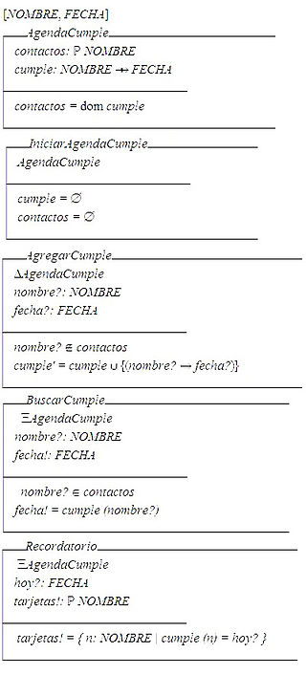
Testing the specification
Specification Languages and Tools
Z notation
Z notation is a formal specification language used for describing and modelling computing systems. It is targeted at the clear specification of computer programs and computer-based systems in general.
Notes:
Z表示法

Slide 37
Testing the specification
Specification reviews
Involve people examining the specification with the aim of discovering anomalies and defects.
Reviewers reuse domain knowledge so they are likely to have seen the types of error that commonly arise.
Does not require the execution of a system so may be used before implementation.
Effective technique for discovering errors.
Notes:
让人们检查规范，以发现异常和缺陷。
这些人能够重复使用领域知识，因此他们很可能已经看到了常见的错误类型。
不需要执行系统，因此可以在实施之前使用。
发现错误的有效技术。

Slide 38
Testing the specification
Reviews and testing
Reviews and testing are complementary and not opposing verification techniques.
Both should be used during the V & V process.
Reviews can check conformance with a specification but not conformance with the customer’s real requirements.
Reviews cannot check non-functional characteristics such as performance, usability, etc.
Notes:
审查和测试是互补的，并不与验证技术相反。
两者都应在V＆V过程中使用。
审核可以检查是否符合规范，但不能符合客户的实际要求。
评论无法检查非功能性特征，例如性能，可用性等。

Slide 39
Testing the specification
Review pre-conditions
A precise specification must be available.
Team members must be familiar with the organization standards.
Management must accept that reviews will increase costs early in the software process.
Management must not use reviews for staff appraisal.
Notes:
审查前提条件

Slide 40
Testing the specification
What is a specification review?
A process of identifying faults in the specification of a software system.
Review should uncover both errors made in producing specification documents, and errors made earlier in the requirements engineering process.
Notes:
识别软件系统规范中的错误的过程。

Slide 41
Testing the specification
Limitations of conventional review approaches
Too much information to go through, and not enough time to do it thoroughly.
Unfamiliarity of individual reviewers with the overall goals of the design.
No single part of the specification gets a thorough and complete evaluation.
One-on-one interaction between individual reviewers and specification team is limited.
Notes:
常规审查方法的局限性

Slide 42
Testing the specification
Better method: Active specification review process
Change from “general” review to a set of more focused reviews.
Use questionnaires to engage the reviewer in using the specification.
More opportunities for one-on-one discussion between reviewer and specification team.
Notes:
更好的方法：主动规范审查过程

Slide 43
Testing the specification
An example
We have been asked to review the specification for a hospital’s order processing system.
The order processing system allows users to order items for patients, such as tests or medications.

Slide 44
Testing the specification
Active specification review process Step 1: Prepare the specification for review
Think about what criteria reviewers will use:
Well-structured
Simple
Adequate
Flexible
Practical
Easy to implement
Standardized
Notes:
主动的规范评审过程
步骤1：准备规范以进行评审

Slide 45
Testing the specification
Active specification review process Step 2: Prepare the documentation for review
Make assumptions explicit
System can record the order pertaining to a patient.
It is possible to obtain all the orders for a patient.
System can determine and change the status of an order.
The order always contains at least one item.
The status of an order is always in one of the two states i.e active or cancelled.
Incorrect Usage Assumptions
Cannot add or remove items once the order is placed.
Once an order is cancelled, the status cannot be set to active again.
An item is always added with respect to an order.
Notes:
步骤2：准备文档以供审核

Slide 46
Testing the specification
Active specification review process Step 3: Identify the specialized reviews
Focus the reviewer’s attention on specific properties of the specification (e.g., data access).
Data access sufficiency.
E.g., provides all data required by the other features of the system.
Assumption Sufficiency.
E.g., contains all of the assumptions needed to access the feature’s data.
Notes:
确定专业审查

Slide 47
Testing the specification
Active specification review process Step 4: Identify the reviewers needed
People with different perspectives and expertise are needed as reviewers
Programmers and analysts who worked on the other features of the order processing system.
Programmers and analysts familiar with hospital information systems in general.
Notes:
步骤4：确定所需的审查者

Slide 48
Testing the specification
Active specification review process Step 5: Design the questionnaires
Make reviewers take an active role
Make reviewers use the documentation
Phrase questions in an active way
E.g., “Write down the exceptions that can occur” rather than “Are exceptions defined for every program?”
Notes:
步骤5：设计问卷

Slide 49
Testing the specification
Active Specification Review Process Step 6: Conduct the review
Present an overview of the specification.
Assign reviews to the reviewers.
Reviewers complete their reviews, meeting with the specification authors as needed.
Specification authors review completed questionnaires, and meet with reviewers to resolve questions.
Specification authors produce new version of the specification.
Notes:
步骤6：进行审查

Slide 50
Testing the specification
Specification attribute checklist
Completeness
Accuracy
Precision
Consistency
Relevance
Feasibility
Code/Design-free
Testability
Notes:
产品说明书属性检查清单
完整性
准确性
精确 不含糊、清晰。
一致性
关联
可行性
无代码/无设计
可测性

Slide 51
Testing the specification
Specification terminology checklist
Always, every, all, none, never, … (absolutely sure?)
Certainly, therefore, clearly, obviously, customarily, most, … (persuasion lingo)
Some, sometimes, often, usually, ordinarily, customarily, most, … (vague)
Etc., and so forth, and so on, such as, … (not testable)
Good, fast, cheap, efficient, small, stable, … (unquantifiable)
Handled, processed, rejected, skipped, eliminated, …
If … then … (missing else)
Notes:
产品说明书用语检查清单
1、总是、每一种、所有、没有、从不。
2、当然、因此、明显、显然、必然。
3、某些、有时、常常、通常、惯常、经常、大多、几乎。
4、等等、诸如此类、依次类推、例如。
5、良好、迅速、廉价、高效、小、稳定。
6、处理、进行、拒绝、跳过、排除。
7、如果...那么...（没有否则）。

Slide 52
Testing the specification
Conclusions
Reviewers focus on those areas they are best suited to evaluate
Time is used more wisely for all participants
More errors are likely to be found
One-on-one communication with specification authors makes it easier for people to speak up.
Few errors found does not necessarily indicate that the specification is good.
E.g., Perhaps the review process was not effective.

Slide 53
Testing the specification
You now know …
… what a specification is
… how to review (test) a specification
… the benefits of an “active” specification review process
Notes:
…什么是产品说明书
…如何查看（测试）产品说明书
…“积极的”产品说明书审查流程的好处

Slide 54
To be continued… See you next week

